Slide 1
Deep Learning in Computer Vision (Part-1)
The Advent – Deep Neural Networks
Computer Vision, 6th Semester, 2024

Slide 2
Neural Networks
Computational models inspired by the human brain's neural structure
Fundamental component of machine learning
Used for a variety of tasks:
classification
regression
pattern recognition

Slide 3
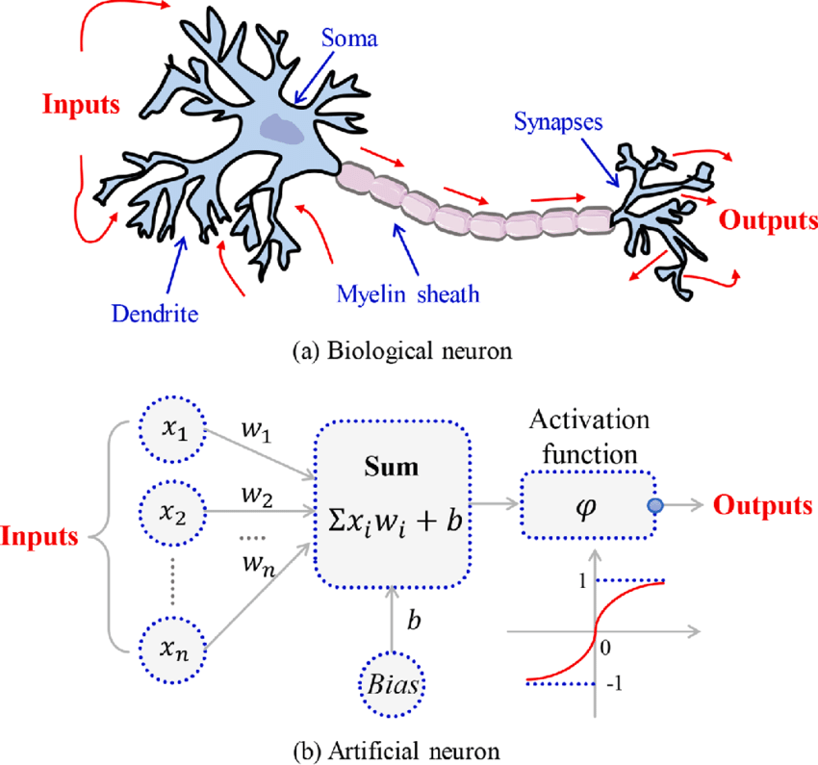
Neurons in Neural Networks
Artificial Neurons:
basic building blocks of neural networks
receive input, perform a computation, and produce an output.
Input:
Each neuron receives one or more inputs:
raw features of the data, or
outputs from other neurons.
Weights:
Each input is associated with a weight, which determines the importance of that input.
Bias:
A bias term is added to the weighted sum of inputs to shift the activation function, allowing the neuron to produce an output even when all inputs are zero.
Activation Function:
The weighted sum of inputs plus bias is passed through an activation function, which introduces non-linearity into the model.

Slide 4
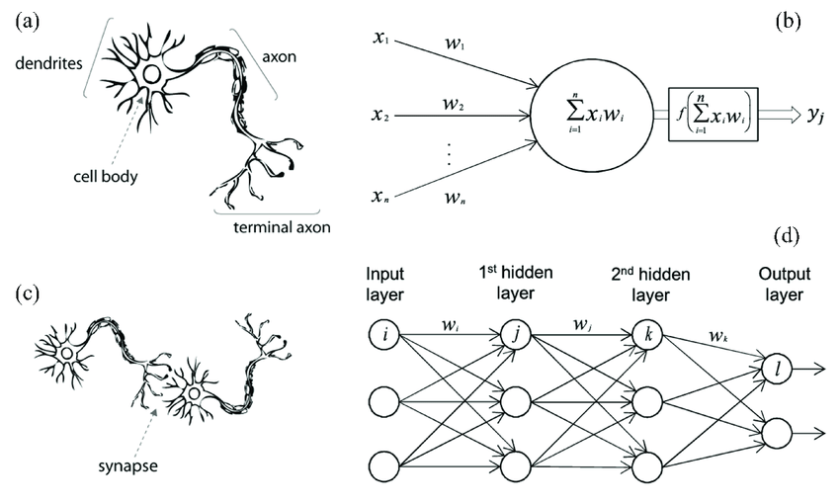
Layers in Neural Networks
Input Layer:
Receives the initial input data.
Hidden Layers:
Intermediate layers between the input and output.
Deep neural networks have multiple hidden layers.
Output Layer:
Produces the final output.

Slide 5
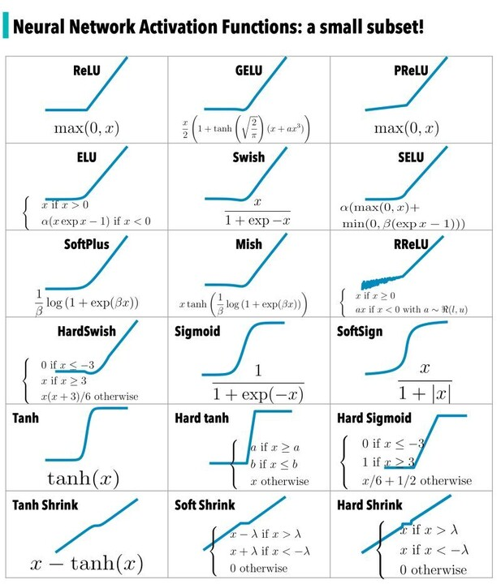
Activation Functions in N.N.
Activation functions introduce non-linearity into the neural network, allowing it to learn from the data.
Examples:
Sigmoid
Tanh
ReLU
Leaky ReLU

Slide 6
Training and Back-propagation

Slide 7
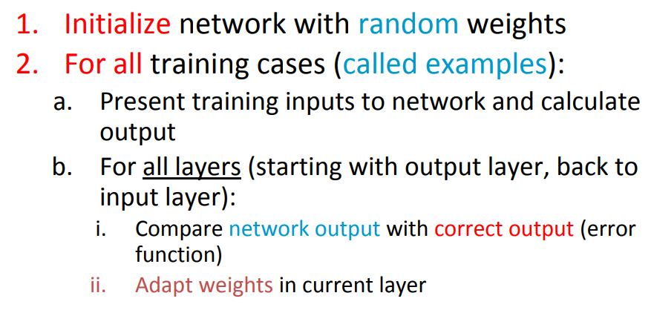
Back-Propagation

Slide 8
Other components of Neural Networks
Training, Validation, and Testing
Overfitting and Regularization
Training Data:
Used to train the neural network by adjusting the weights and biases.
Validation Data:
Used to tune hyperparameters and prevent overfitting.
Test Data:
Used to evaluate the performance of the trained model on unseen data.
Large number of parameters – data memorization – overfitting
Regularization techniques – used to prevent overfitting and improve generalization
Dropout
L1/L2 regularization
Early stopping

Slide 9
Deep Neural Networks
Depth of NN – number of computational layers
Shallow NN – few hidden layers (1-2)
Deep NN – several hidden layers
Deep NNs can learn intricate patterns in various levels of feature analysis from the data

Slide 10
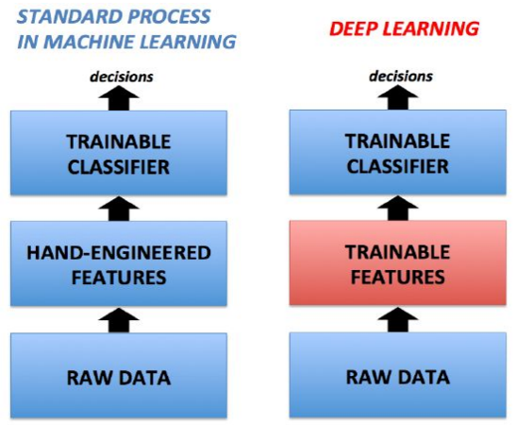
Machine Learning Vs Deep Learning
Machine Learning models use hand-crafted features from input data in order to classify or predict.
Deep Learning models have feature extraction layers that are not exactly hand-crafted (with description) but are learnable to directly recognise and predict from.

Slide 11
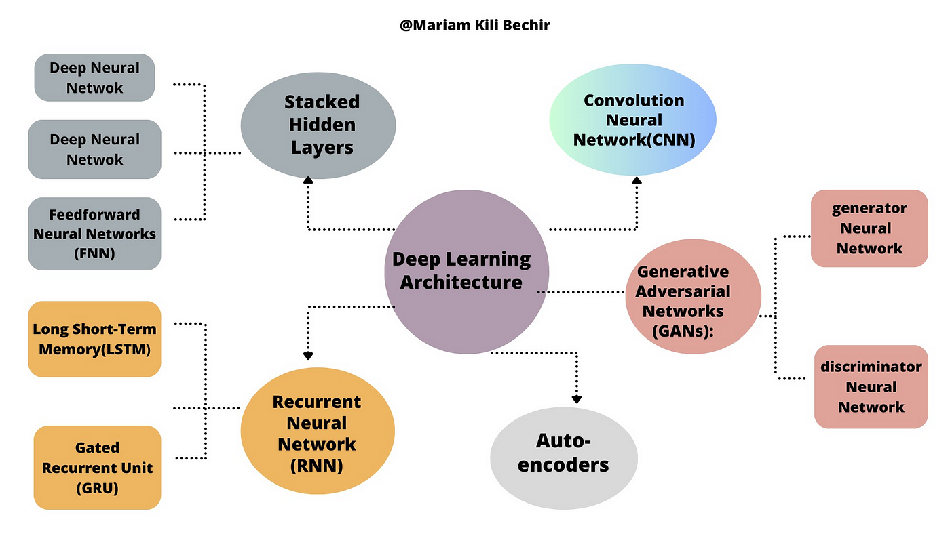
Types of Deep Neural Networks

Slide 12
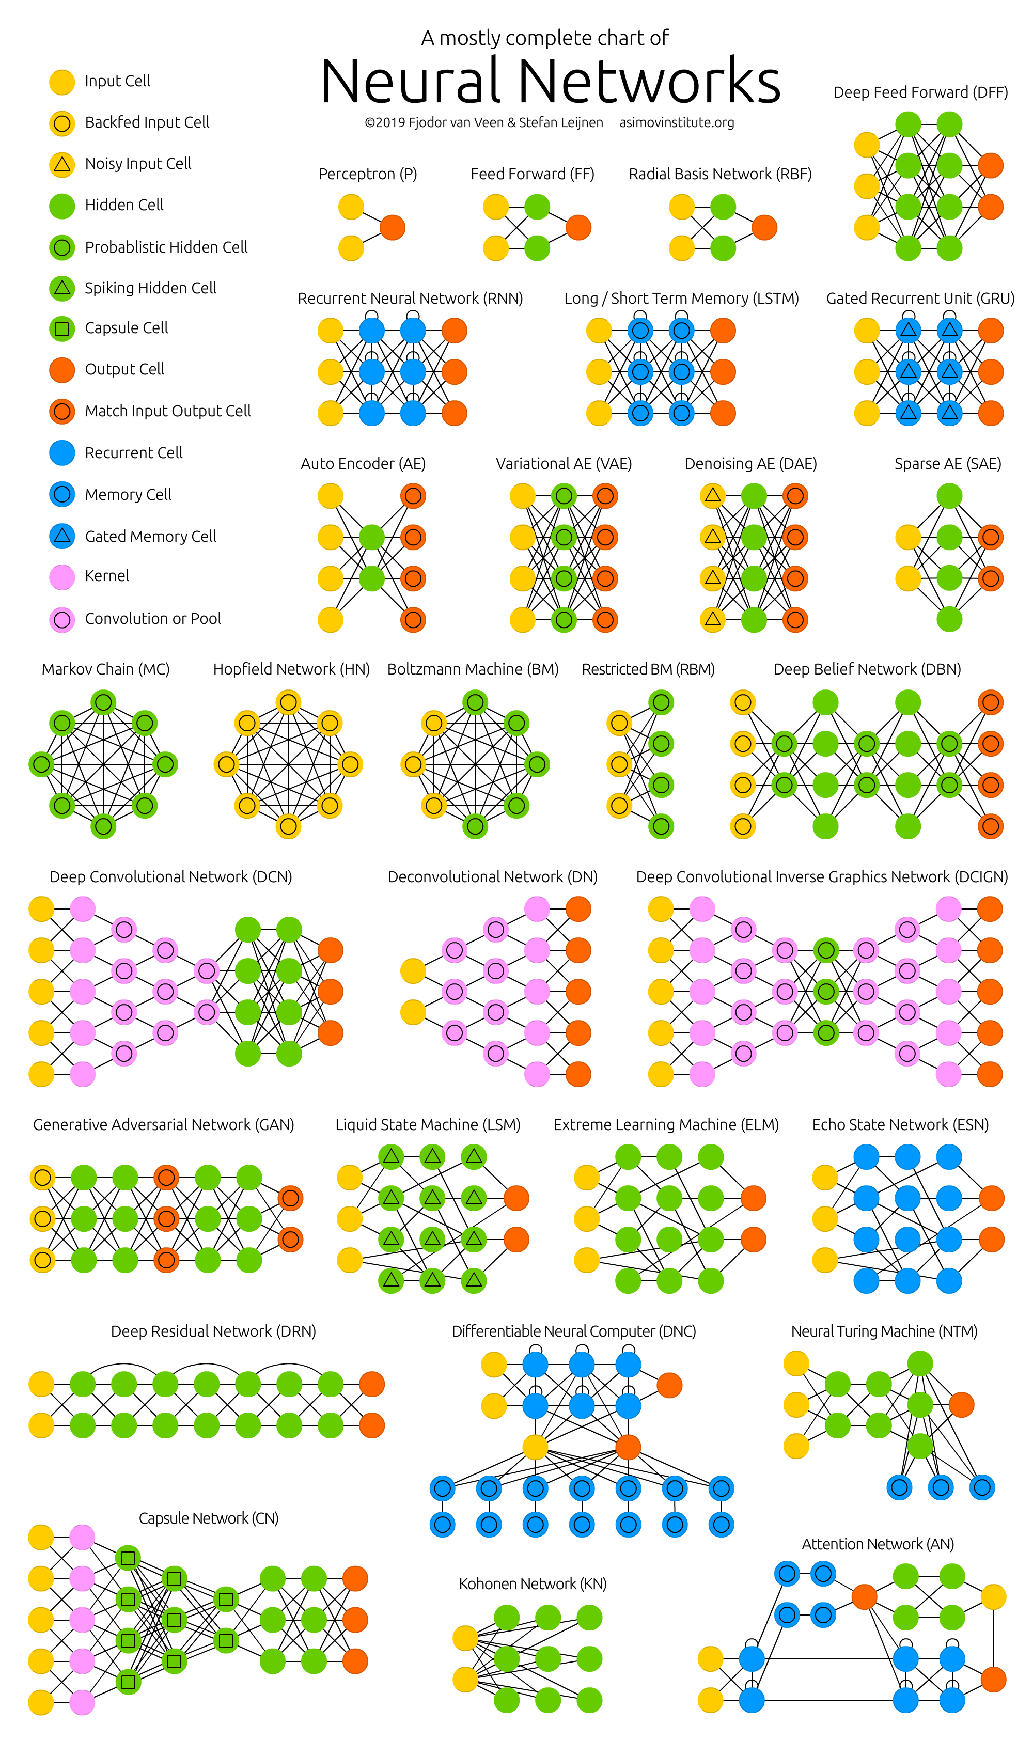
Various types of Neural Networks
Source:
The Neural Network Zoo.
https://www.asimovinstitute.org/neural-network-zoo/

Slide 13
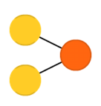
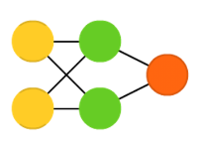
Types of Neural Networks (shallow and deep)
Perceptron
Multi-layer Perceptron
(feed forward neural network)

Slide 14
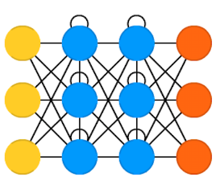
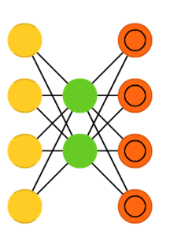
Types of Neural Networks (shallow and deep)
Recurrent Neural Network
Autoencoder

Slide 15
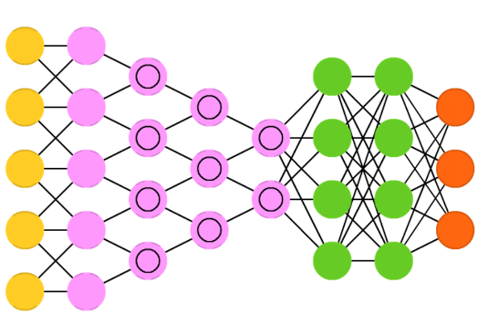
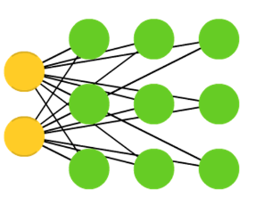
Types of Neural Networks (shallow and deep)
Convolutional Neural Network
Kohonen Self-Organizing Map

Slide 16
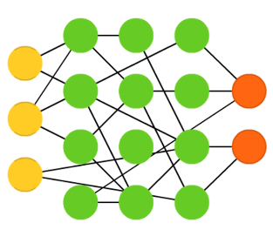
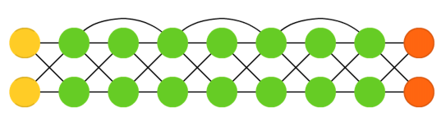
Types of Neural Networks (shallow and deep)
Extreme Learning Machine
Residual Network

Slide 17
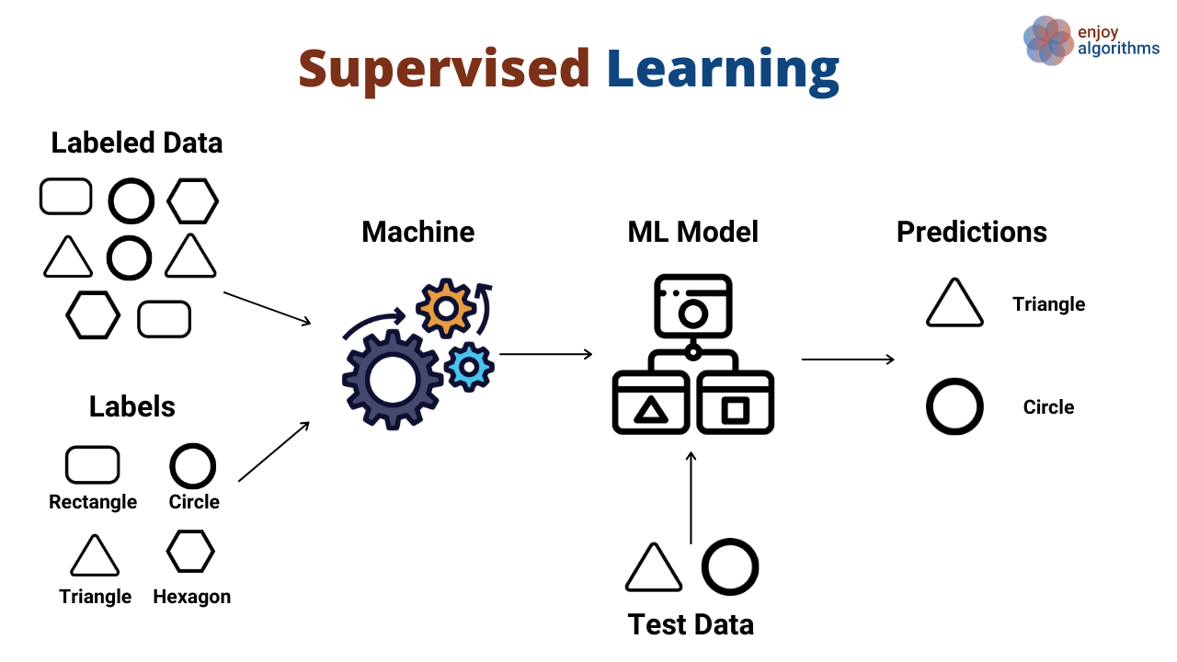
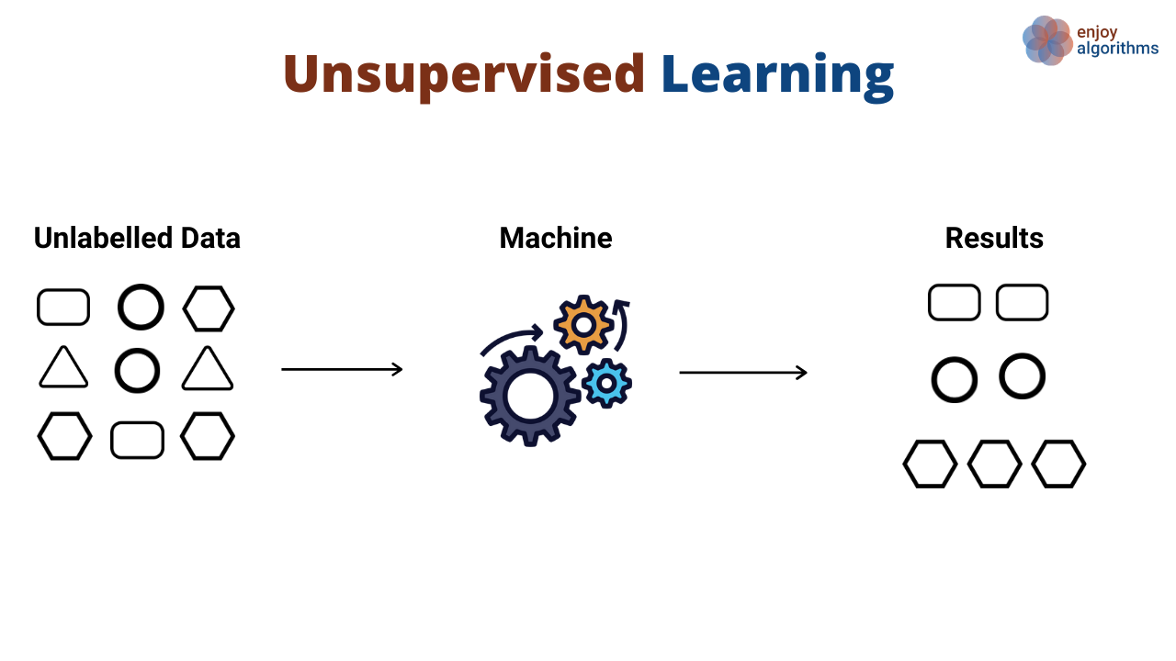
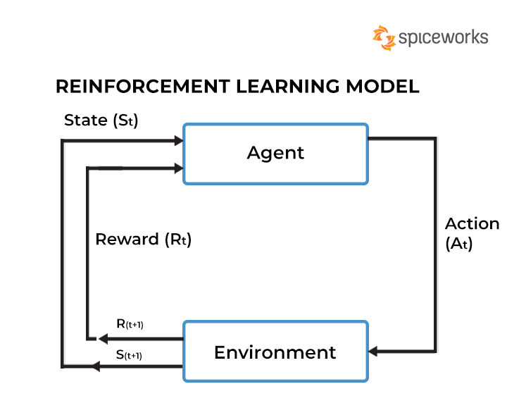
Types of Learning
Supervised
Unsupervised
Reinforcement

Slide 18
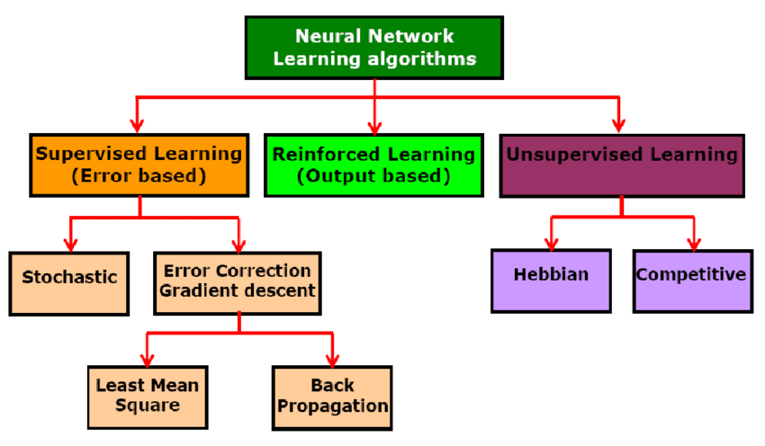
Types of Learning in Neural Networks

Slide 19
Applications of Deep Neural Networks
Image and video recognition
Natural language processing
Speech recognition
Autonomous driving
Healthcare diagnostics
Financial forecasting, etc.

